Slide 1
Mutation Testing: Midterm Presentation
Marian Lusk
Mehrnoush Sotoudeh
SE4367

Slide 2
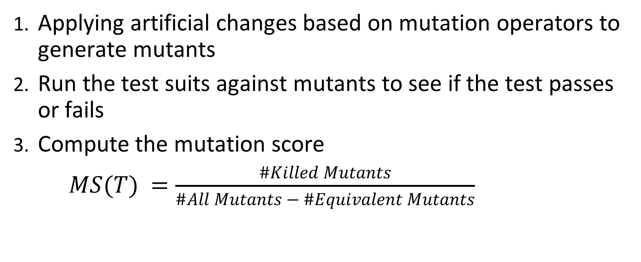
Steps for mutation testing:
Applying artificial changes based on mutation operators to generate mutants
Run the test suits against mutants to see if the test passes or fails
Compute the mutation score
$MS(T) =\frac{\#Killed Mutants}{\#All Mutants − \#Equivalent Mutants}$
Notes:
The first step in mutation testing is applying artificial changes based on mutation operators to generate mutants. It is important to consider that each mutant has to have only one artificial bug. The next step is to run the test suits against mutants to see if it fails or passes. If a test suite does not fail, it may indicate that the test suite has issues. The last step is to compute the mutation score.

Slide 3
What is PIT?
Mutation testing system which provides gold standard test coverage for java and the jvm. Benefits include:
fast - can analyze in minutes what could take earlier systems days
easy to use - works with maven, ant, gradle and others
actively developed
actively supported

Slide 4
Getting started - PIT
Locate a copy of the PIT source code
Pitest.org contains a link to the git repository where PIT is hosted
Clone a copy of the source code from a repository owned by Henry Coles https://github.com/hcoles/pitest.git
Edit the Pom file in test code to match the PIT version

Slide 5
Implementing Mutators in PIT
Create a new instance of MethodsMutatorFactory
Create a new methodVisitor to do the work of creating the mutant
Update org.pitest.mutationtest.engine.gregor.config.Mutator
Update the Pom.xml file to call your mutators
Notes:
Marian starts

Slide 6
AOR: Arithmetic Operator Replacement
Replaces +, -, *, /, % with the four other arithmetic operators
Basis for implementation: current Math Mutator
Math mutator: creates similar mutations
- Math Mutator uses HashMap
- Each key must be unique.
- Separated into 4 AOR classes. Used together, fully implements AOR.

Slide 7
ROR: Relational Operator Replacement
Replaces >, <, >=, <=, ==, != with one of the 5 different relational operators
Basis for implementation: Conditionals Boundary Mutator
replaces >= → >
- Similar problem as AOR
- seperated into 5 AOR classes

Slide 8
AOD: Arithmetic Operator Deletion
AOD: deletes arithmetic operators (example a + b → a)
Basis for implementation: Remove Conditionals Mutator
ex: if (a ==b) → if (true)
- Create a class that extends directly from MethodVisitor
- Override: visitInsn(int opcode) in MethodVisitor
- Class interacts directly with the stack
Notes:
ROR uses AbstractJumpMutator extends MethodVisitor and AOR uses AbstractInsnMutator extends MethodVisitor. In both the other two mutants we merely had to create an instance of a MethodVisitor, AOD has to create a class that extends directly from MethodVisitor to override visit zero operand instructions. Uses other classes created by Henry Cole: Mutation Identifier (uniquely identifies a mutation), MethodMutationContext (class context, instruction index, location), ClassContext (use the shouldMutate method)

Slide 9
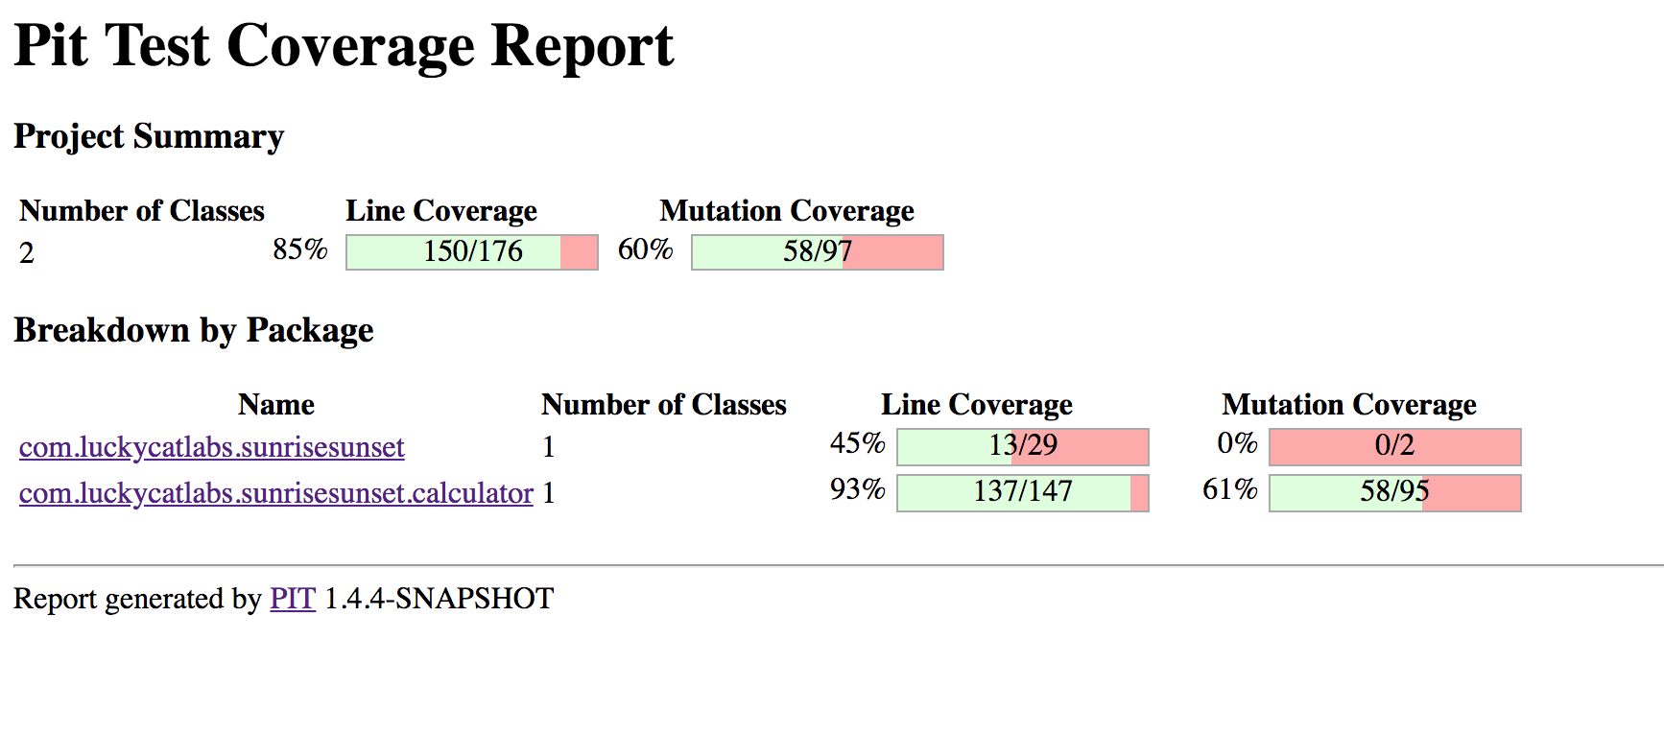
Results: Sunrise/SunsetLib - Java
Notes:
Mary: We’ll first go over our results from two smaller projects.
97 mutants created. 58 Were killed. 60% mutation coverage. Ran with ROR,AOR, AOD.

Slide 10
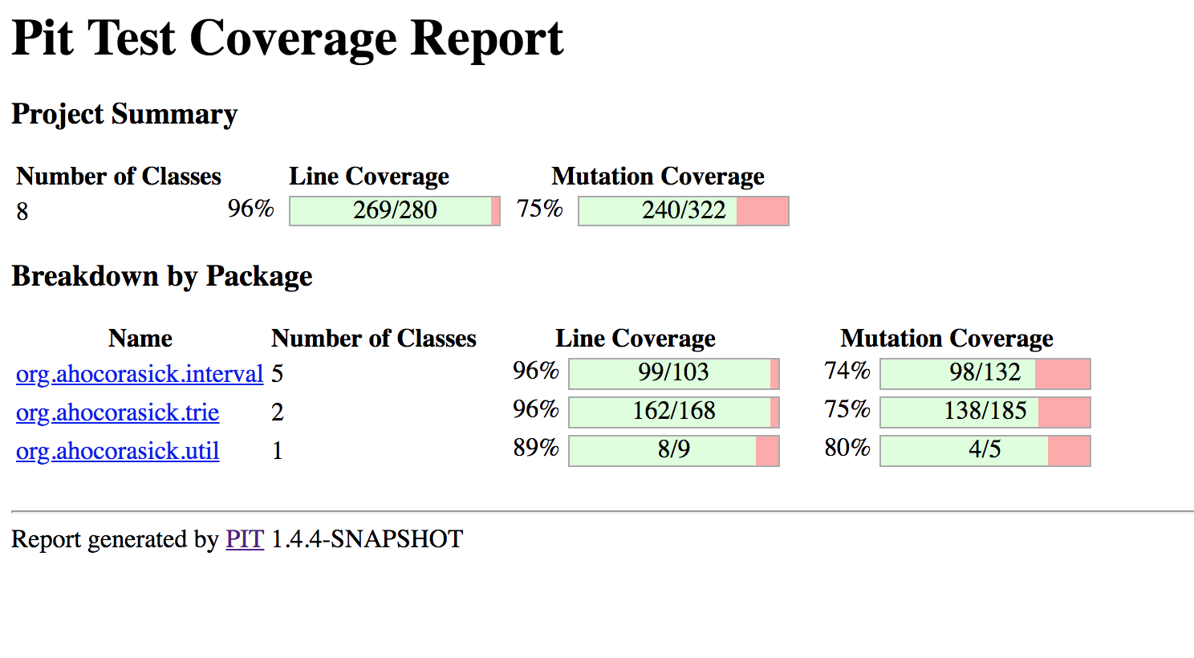
Results: Aho-Corasick-Java
Notes:
Generated 322 mutants. Killed 240. 75% coverage. Ran with AOR, ROR, AOD.

Slide 11
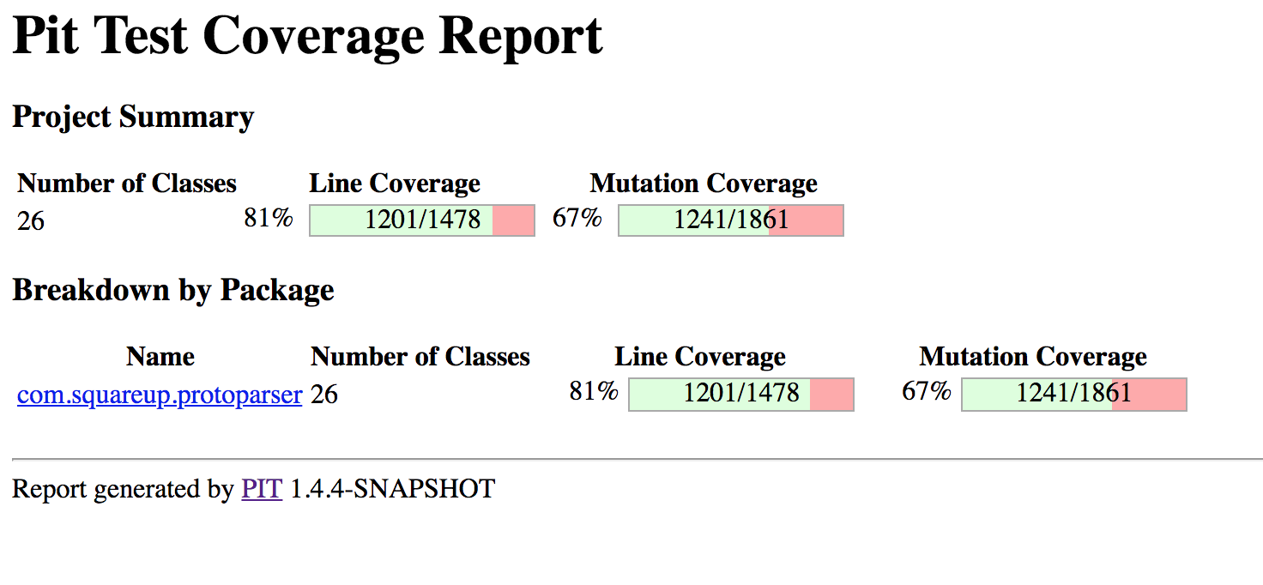
Results:Protoparser-Java
Notes:
Mary: The next three results were from larger projects.
Created 1,861 mutants. Killed 1241. Coverage 67% Ran with ROR, AOR and AOD.

Slide 12
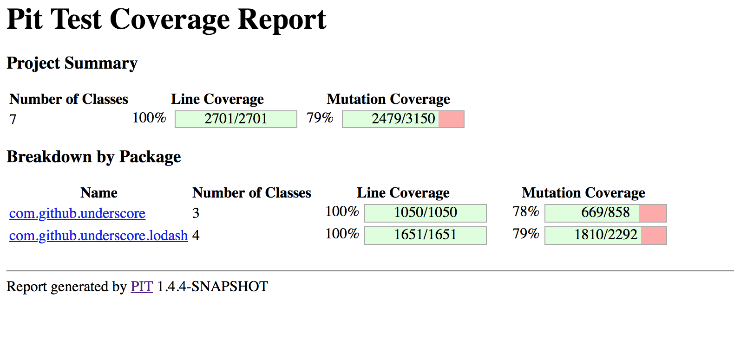
Results: Underscore-Java-Master
Notes:
3,150 mutants. 2,479 killed. 79% mutation coverage. Ran with AOR, ROR, and AOD.

Slide 13
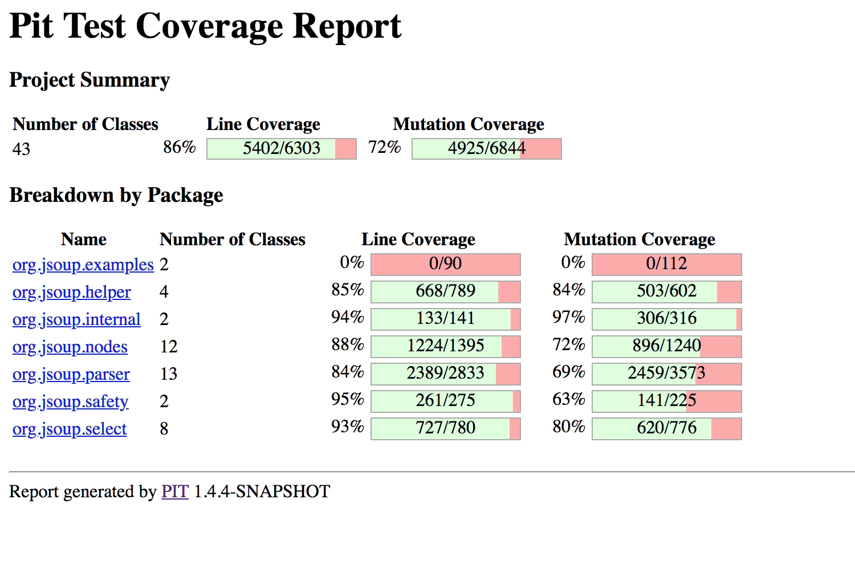
Results: JSoup - Java
Notes:
Created 6,844 mutants. Killed 4,925. 72% Coverage. Ran with AOR, ROR, and AOD.

Slide 14
Phase 2 and Demo
Phase 2: Option 1 Groovy
-Sample project
Notes:
PIT applies at the JVM bytecode level, which means it can be adapted/modified to work for other JVM languages. In this option, you are encouraged to modify PIT to make all its mutators (including default ones, experimental ones, and your augmented ones in Phase-1) working for another JVM language. Furthermore, you are going to apply PIT mutation to fix bugs for another JVM language. Feel free to choose your favorite JVM language to work on from the following set: {Groovy, Clojure, Ceylon, Jython}. Note that you need to carefully report which mutators are directly applicable to the language you choose, and what you do to make the other mutators work. The grading will be based on the efforts you made during the process. Then, evaluate the modified PIT tool on 5 real-world projects in the chosen JVM language from GitHub (with >200 lines of code and > 20 tests).

Slide 15
Special thanks to...
TA: Samuel Benton
Henry Coles

Slide 16

Questions?

